Slide 1
Automating RLHF
Team : Trisha Reddygari(Lead)
Varun Dudipala
Alekhya Marni

Slide 2
Introduction
Background:
• Aligning language models with human preferences is critical for better AI systems.
• RLHF uses human feedback for fine-tuning, but traditional methods require extensive human annotations.
Project Goal:
• Automate RLHF to streamline fine-tuning.
• Benefits include efficiency, scalability, and the ability to train models that better align with human preferences.

Slide 3
Model before and after RLHF
▪Pre-RLHF Outputs:
▪- Literal and often misaligned responses.
▪- Inconsistent quality with verbose or off-topic outputs.
▪
▪Post-RLHF Outputs:
▪- Aligned, coherent, and user-preferred responses.
▪- Improved relevance, coherence, and satisfaction.
▪
▪Impact of RLHF:
▪- Transforms models to align with human preferences.
▪- Produces contextually appropriate and practical outputs.

Slide 4
Materials
1. Dataset Used:
• OpenAI WebGPT Comparisons Dataset:
• Consists of human annotations comparing pairs of answers.
• Provides human preference scores to guide reward model training.
2. Tools:
• PyTorch: For model implementation.
• Vast.ai: GPUs for training.
• Proximal Policy Optimization (PPO): For RL-based fine-tuning.

Slide 5
Model comparison
Model Name | Description | Pros | cons
BERT Sequence Classification (Reward Model) | A BERT-based model fine-tuned to predict human preference scores. For example, given a question and a model-generated answer, it outputs a scalar representing how closely that answer aligns with human-like preferences. | - Strong performance on classification tasks - Leverages rich language understanding - Can directly output a preference score | -Requires labeled preference data for fine-tuning - May be sensitive to domain shifts
PPO Fine-Tuned GPT-2 (Policy Model) | A GPT-2 language model fine-tuned using Proximal Policy Optimization (PPO) guided by the BERT reward model. For example, the policy model generates candidate answers, receives a reward from the BERT model, and updates its parameters to produce more human-aligned outputs over time. | - Improves generation quality by aligning with learned preferences - Iteratively refines outputs via RL - Flexible and adaptable | - RL training adds complexity and computational cost - Sensitive to reward model quality and tuning parameters

Slide 6
BERT architecture
Overview of BERT:
• Bidirectional Encoder Representations from Transformers (BERT) is a transformer-based model designed for natural language understanding tasks.
• It uses self-attention and feed-forward layers to process input text in a bidirectional manner, enabling context-aware embeddings.
Layers:
1. Input Layer:
• Tokens like [CLS], words, and [SEP].
• Represented as embeddings (word + segment + position).

Slide 7
BERT architecture
2. Multi-Layer Encoder:
• Multiple transformer encoder layers, each with:
• Self-Attention Heads
• Feed-Forward Neural Network
• Residual connections and layer normalization for stability.
3. Output Layer:
• Token embeddings for downstream tasks (e.g., sequence classification).

Slide 8
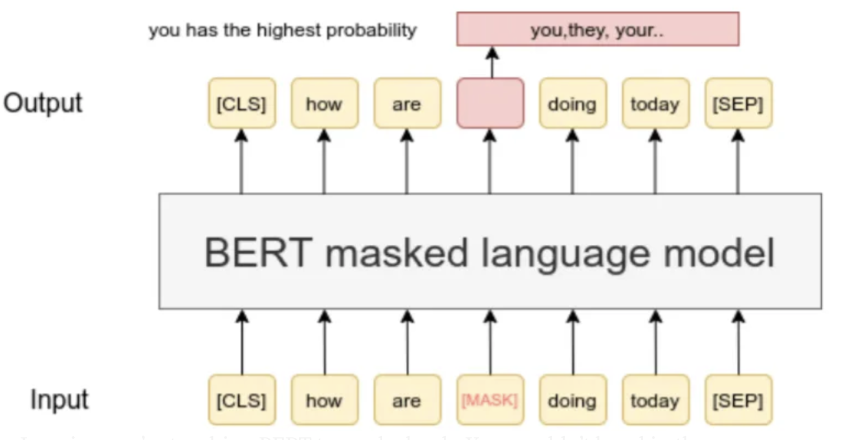
BERT architecture

Slide 9
Methods
Methods
1. Training the Reward Model:
• Used BERT for Sequence Classification.
• Normalized scores from the WebGPT dataset for regression tasks.
• Optimized using training/validation loss.
2. Fine-Tuning the Policy Model:
• GPT-2 augmented with a value head.
• PPO leveraged feedback from the reward model for fine-tuning.
• Key Steps:
• Tokenized input/output text.
• Fine-tuned over multiple epochs.
• Adjusted hyperparameters like learning rate and batch size.

Slide 10
Methods
Methods
3. Hyperparameter Tuning:
• Tuned trajectory length, number of episodes, and target rewards.
• Experimented with different values for learning rate and batch size.

Slide 11
Steps to Reproduce
1. Collect Training Data:
• Use OpenAI WebGPT dataset.
2. Train Reward Model:
• Normalize scores and train BERT.
3. Fine-Tune Policy Model:
• Input reward model outputs into GPT-2 via PPO.
4. Optimize Hyperparameters:
• Experiment with trajectory lengths, learning rates, and reward metrics.
5. Evaluate Results:
• Compare pre- and post-training model outputs.

Slide 12
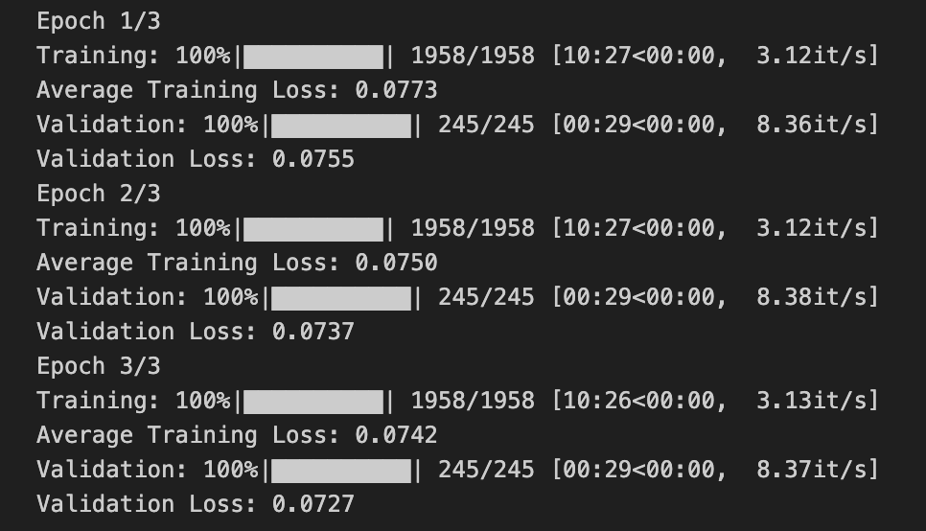
Results

Slide 13
Discussion/Conclusion
Key Findings:
• Automating RLHF improved language model alignment with human preferences.
• Reward model effectively guided policy fine-tuning.
Challenges:
• High computational costs.
• Sensitivity to dataset bias and limitations of WebGPT data.
Future Work:
• Explore larger datasets and more complex RL algorithms.
• Enhance model generalization for broader applicability.

